Slide 1


AI-DRIVEN BLINK AND FACIAL EMOTION DETECTION FOR PARALYSIS PATIENTS Presented by, SAMYUKTHA B (312422106141) SUBASHRI M (312422106161) Guided by, Ms. A. JEMIMA HAVILA CATHERINE,M.E.., Assistant Professor

Slide 2
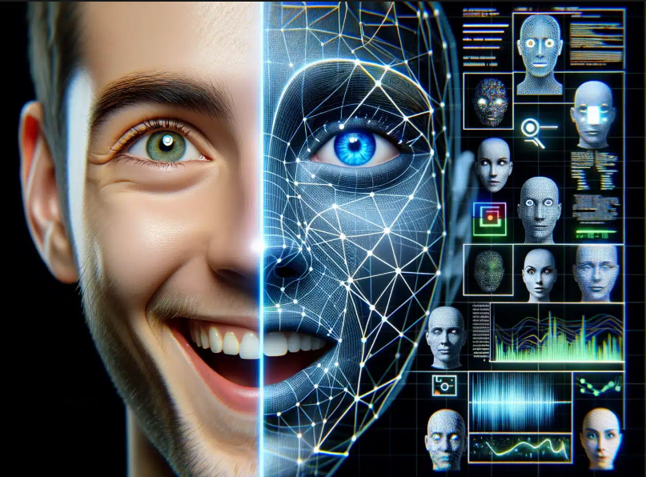
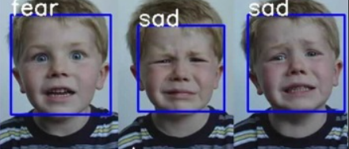
OBJECTIVE
The main objective of this project is to design and develop an AI-based assistive system that enables real-time blink and facial emotion detection for paralysis patients, improving non-verbal communication and enhancing quality of life.
Specific objectives include:
To detect eye blinks and facial expressions using a web camera and process the data through an AI model.
To use an ESP32 microcontroller for handling sensor input and communication with peripheral devices.
To display real-time status and feedback using an LCD display for on-site observation.
To send alerts and facial emotion data remotely via Wi-Fi using the Blynk app for caregiver monitoring.

Slide 3
LITERATURE SURVEY
S. NO. | TITLE OF THE PAPER WITH AUTHOR NAME | JOURNAL NAME | YEAR OF PUBLICATION | METHODOLOGY | PROS & CONS
1 | Adaptive Real-Time Eye-Blink Detection System Authors: Mai K. Galab, H. M. Abdalkader, Hala H. Zayed | INTERNATIONAL JOURNAL OF COMPUTER APPLICATIONS | 2014 | This system employs a standard webcam to detect eye blinks without requiring infrared light or physical markers. It utilizes image processing techniques to classify eyes as open or closed in each video frame, functioning effectively in both online and offline environments. | Pros : 1.Non-intrusive and user-friendly. 2.Operates without the need for infrared light or special equipment. 3.Suitable for user wearing glass. Cons : 1.Performance may degrade under varying lighting conditions. 2.Sensitivity to specular reflections can affect accuracy
2 | Efficient Eye Blink Detection Method for the Disabled Authors: Venki B, Sanath Kumar K, Sajid Kamran, Vasanthi Satyananda | PERSPECTIVES IN COMMUNICATIONEMBEDDED-SYSTEMS AND SIGNAL-PROCESSING (PICES) | 2021 | The study introduces a cost-effective device that translates eye blinks into Morse code, facilitating communication for individuals with speech impairments.
Pros:
1.Affordable and accessible solution.
2.Utilizes readily available smartphone technology.
Cons:
1.Accuracy is dependent on consistent lighting conditions.
2.Requires the user to maintain a fixed distance from the camera.
3

Slide 4
S.NO. | TITLE OF THE PAPER WITH AUTHOR NAME | JOURNAL NAME | YEAR OF PUBLICATION | METHODOLOGY | PROS & CONS
3 | Deep Learning-Based Facial Emotion Recognition for Human–Computer Interaction Applications Authors: M. Kalpana Chowdary, Tu N. Nguyen, D. Jude Hemanth | NEURAL COMPUTING AND APPLICATIONS | 2023 | The research employs deep convolutional neural networks (CNNs) with transfer learning techniques using architectures like ResNet50 and VGG19 to recognize facial emotions. The system is designed for integration into human–computer interaction applications.
4 | Convey: Developing a Facial Emotion Recognition System for Enhancing Interpersonal Interactions of Children with Autism Spectrum Disorders Authors: Janah Rose R. Fernandez, Brigette Anne P. Magparangalan, Kent Joaquin B. Pades, et al. | JOURNAL OF ELECTRICAL SYSTEMS | 2024 | The study introduces "Convey," a mobile application integrating facial emotion recognition to aid children with Autism Spectrum Disorders (ASD) in understanding and expressing emotions. The system utilizes CNNs for emotion detection and includes features like mood tracking and relaxation technique recommendations. | Pros:
Pros
1. High accuracy in emotion recognition.
2.Effective in real-time applications.
Cons:
Requires substantial computational resources.
Performance may vary with different lighting .
1.User-friendly mobile application tailored for children with ASD.
2.High accuracy in emotion detection.
Cons:Effectiveness may vary based on individual differences among users.
Requires consistent user engagement for optimal benefits.

Slide 5
S.NO. | TITLE OF THE PAPER WITH AUTHOR NAME | JOURNAL NAME | YEAR OF PUBLICATION | METHODOLOGY | PROS & CONS
5 | Emotion Detection in Children with Autism Spectrum Disorder Leveraging EEG Signals and Companion Bots for Enhanced Interaction Authors: Fredj Ahmed, Gurram Srinivasa, Danie John, Shajin Prince, Bini D. | IET CONFERENCE PROCEEDINGS | 2024 | This paper explores a multimodal approach combining EEG signals and facial expressions to detect emotions in children with ASD. The system employs machine learning algorithms and integrates companion robots to facilitate improved social interactions.
6 | Blink Detection Using 3D Convolutional Neural Architectures and Analysis of Accumulated Frame Predictions Authors: George Nousias, Konstantinos K. Delibasis, Georgios Labiris | SCIENTIFIC REPORTS | 2025 | This study proposes deep learning architectures utilizing 3D convolutional neural networks (CNNs) to detect blinks in video sequences. The approach involves training an eye detector to extract eye regions from each video frame, organizing these as three-dimensional inputs over a 300 ms time span. | Pros:
1.Multimodal data enhances emotion detection accuracy.
2.Integration with companion bots offers interactive support.
Cons:
1.EEG data collection can be intrusive and may cause discomfort.
Pros:
1.High accuracy in blink detection due to temporal analysis.
2.Suitable for real-time applications in assistive technologies
Cons:
Requires high-frame-rate video input, which may not be feasible in all settings.

Slide 6
EXISTING SYSTEM
Existing systems for AI-driven blink and facial emotion detection for paralysis patients focus on enhancing communication and interaction for individuals with limited mobility. Blink detection systems, using computer vision and machine learning algorithms, monitor eyelid movements to track blinks, offering a non-invasive method for patients to signal attention or intent.
These systems often rely on facial landmark detection or infrared sensors to detect blinks in various lighting conditions.
Assistive technologies integrate blink detection with communication tools, enabling patients to select words or phrases on a screen by blinking, or generating speech based on detected emotions.

Slide 7
PROBLEMS FACED
Accuracy of Blink Detection
Limited Facial Expression Range
Real-time Processing Challenges
Limited Integration with Other Assistive Technologies
Dependence on Controlled Environments
Complex Setup and Maintenance
Privacy and Security Concerns
Limited Customization
Cost and Accessibility
User Fatigue

Slide 8
PROPOSED SYSTEM
The proposed system for AI-driven blink and facial emotion detection for paralysis patients focuses on enhancing accuracy, adaptability, and user experience. It incorporates advanced deep learning models, such as CNNs or RNNs, to improve blink detection, even for patients with minimal or irregular eye movements, and integrates infrared sensors or eye-tracking devices for reliable performance in low-light conditions.
The facial emotion recognition system is designed to detect subtle facial expressions, especially for patients with partial facial paralysis, by combining multiple feature extraction techniques to ensure accurate emotion analysis. Real-time processing is achieved through edge devices like the ESP32 or Raspberry Pi, optimizing algorithms for low-power consumption without compromising speed. To address environmental challenges, the system adapts to varying lighting conditions and filters background noise, ensuring reliable performance in both controlled and uncontrolled environments.

Slide 9
METHODOLOGY
Data Collection and Preprocessing
Model Training and Optimization
System Integration and Hardware Setup
User Interface and Interaction
Testing and Calibration
Deployment and Maintenance

Slide 10
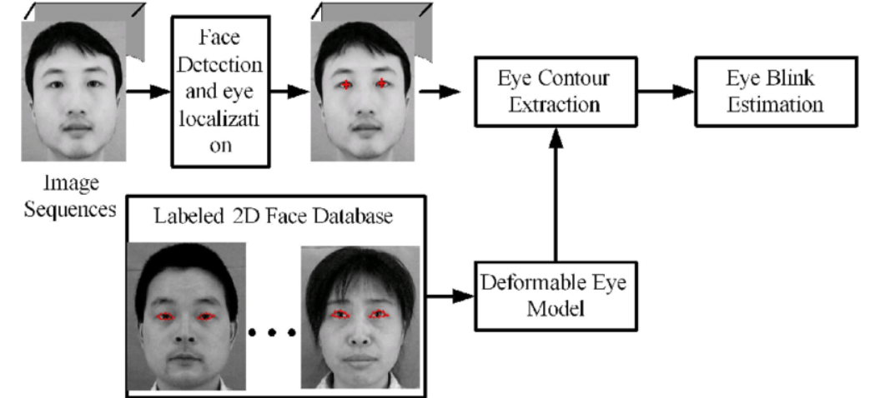
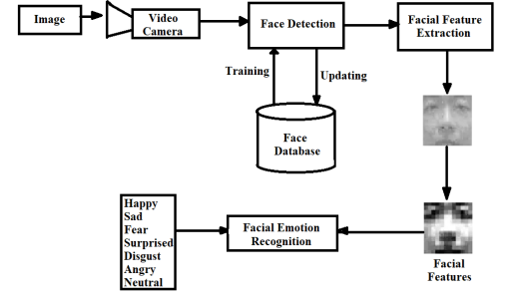
BLOCK DIAGRAM

Slide 11
BLOCK DIAGRAM DESCRIPTION
The block diagram illustrates the complete workflow of our project: AI-Driven Blink and Facial Emotion Detection for Paralysis Patients using an ESP32 and webcam.
Image Capture: The system begins by capturing input through a video camera.
Face Detection: Detected faces are identified using trained models stored in a face database, which is continuously updated.
Facial Feature Extraction: Key facial features are extracted from the detected face images for further analysis.
Facial Emotion Recognition: Using these features, the system classifies emotional states such as happy, sad, fear, surprise, disgust, anger, and neutral.
Blink Detection Process:
The video stream undergoes face and eye localization.
Image sequences are compared with a labeled 2D face database.
A deformable eye model helps accurately model eye shape and position.
Eye contour extraction is used to analyze the eyelid movement.
Finally, eye blink estimation determines blink frequency or intentional blink signals.

Slide 12
ALGORITHM
Step 1: Start Webcam Feed Begin capturing live video frames using OpenCV from the connected webcam.
Step 2: Face Detection Detect faces in each frame using algorithms like Haar Cascade or Dlib.
Step 3: Facial Landmark Detection Identify key facial points such as eyes, nose, and mouth using a landmark model.
Step 4: Eye Region Extraction Extract the eye area and compute the Eye Aspect Ratio (EAR) for blink analysis.
Step 5: Blink Detection Detect blinks by monitoring changes in EAR across video frames.
Step 6: Feature Extraction for Emotion Extract facial features using CNN models or facial geometry for emotion analysis.
Step 7: Facial Emotion Classification Classify emotions using a pre-trained deep learning model into categories like happy, sad, etc.
Step 8: Display Results Show the detected emotion and blink status on a live video stream via the web interface.
Step 9: Send Data to ESP32 / Blynk Transmit emotion or blink data to ESP32 for assistive control or notification.

Slide 13
SIMULATION TOOLS USED
HARDWARE REQUIREMENTS
Webcam – For capturing real-time video input (e.g., USB or laptop camera)
ESP32 Microcontroller – For triggering external actions or communication
Laptop or PC – To run the AI model and host the web interface
LCD Display (optional) – To show output from ESP32 if required
Power Supply/USB Cables – For powering ESP32 and webcam
SOFTWARE REQUIREMENTS
The tools required are:
Python – Core programming language used for AI processing
OpenCV – For capturing video and image processing
Dlib / Mediapipe – For facial landmark detection
Keras / TensorFlow– For training or running the emotion classification model
Flask – For building and running the local web interface (127.0.0.1:5000)
Blynk Platform – For IoT integration and sending notifications via ESP32
Arduino IDE – For programming ESP32

Slide 14

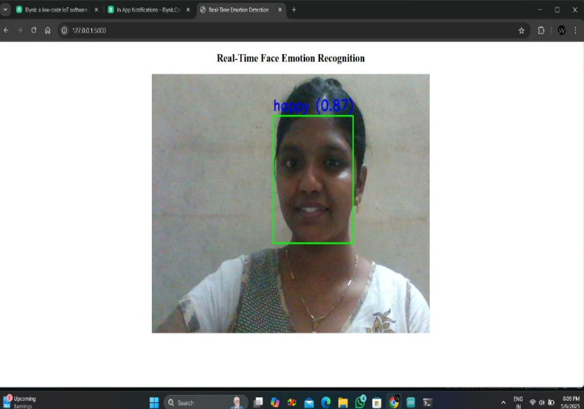
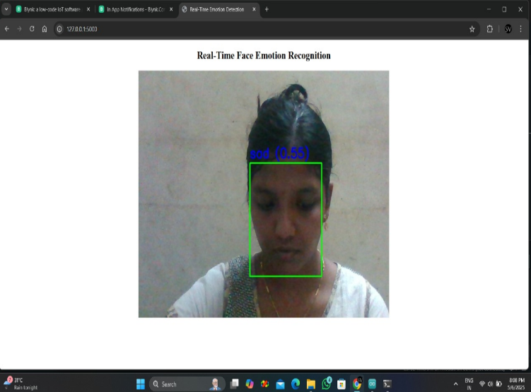
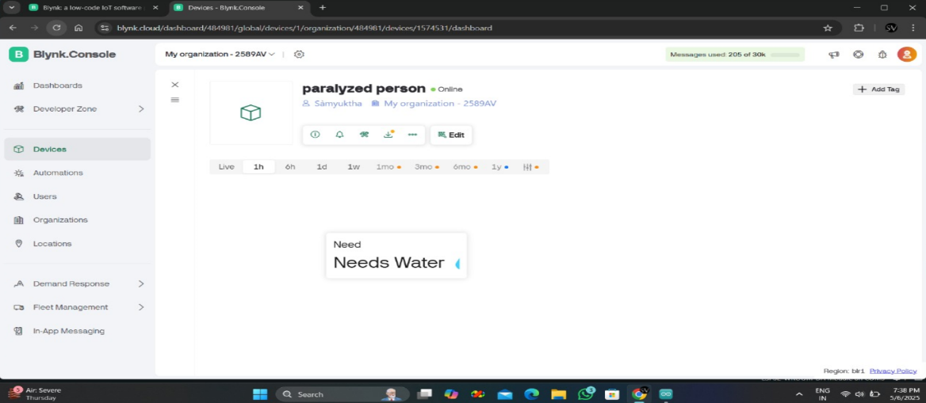
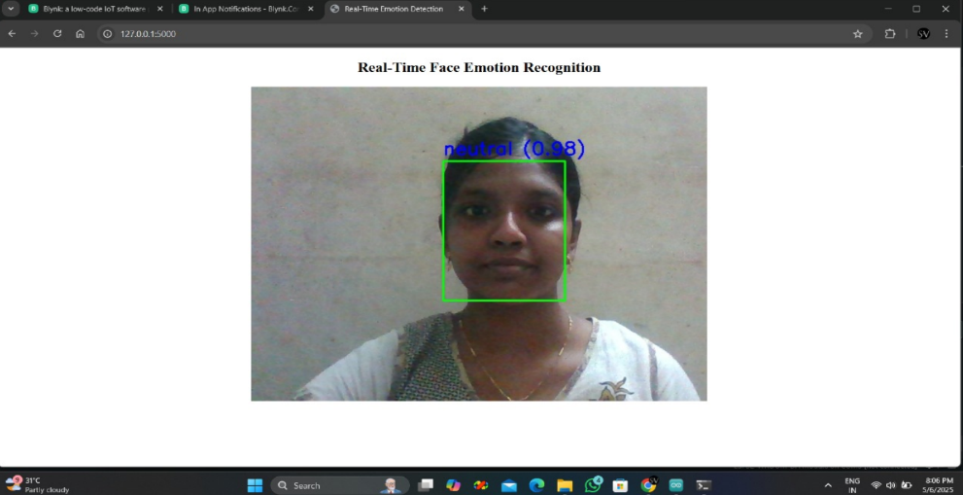
OUTPUT IMAGE
BLINK DETECTION OUTPUT FACIAL EMOTION DETECTION
Notes:
BLINK DETECTION

Slide 15
RESULTS & DISCUSSION
The system successfully captured real-time facial data using a webcam and accurately detected eye blinks and emotional expressions through a user-friendly web interface. Blink detection worked reliably by monitoring the Eye Aspect Ratio (EAR), with consistent accuracy in differentiating between intentional and natural blinks.
The facial emotion recognition model classified emotions such as happy, sad, angry, and neutral with high precision on test subjects under good lighting conditions.
Integration with the ESP32 microcontroller enabled blink or emotion-based triggers, allowing potential communication assistance for paralyzed patients. The live web interface (127.0.0.1:5000) provided real-time visual feedback, making it intuitive and accessible.

Slide 16
CONCLUSION & FUTURE ENHANCEMENT
Our project successfully demonstrates how AI-powered blink and facial emotion detection can provide a meaningful communication bridge for paralysis patients. By integrating a webcam, ESP32, and real-time emotion recognition, we enable intuitive and non-verbal interaction with caregivers or systems. This solution enhances independence, improves quality of life, and lays the foundation for future advancements in assistive healthcare technologies. This project marks a step forward in merging AI with assistive technology to empower differently-abled individuals."
FUTURE ENHANCEMENTS:
Voice Feedback Integration for emotion or blink-based commands
Mobile App Control using Blynk for remote monitoring
Advanced Emotion Detection with more facial cues and expressions
Battery-Powered Setup for portable and wireless use
Integration with Assistive Devices like wheelchair control

Slide 17
REFERENCES
[1]. Alberto J. Molina-Cantero, Clara Lebrato-Vázquez, Manuel Merino-Monge, Roylán Quesada-Tabares, Juan A. Castro-García and Isabel M. Gómez-González “Communication Technologies Based on Voluntary Blinks: Assessment and Design” Received April 10, 2019, accepted May 20, 2019, date of publication May 27, 2019, date of current version June 11, 2019.
[2]. Kingshuk Mukherjee, Devdutta Chatterjee “Augmentative and Alternative Communication Device Based on Eye-Blink Detection and Conversion to Morse-Code to Aid Paralyzed Individuals” 2015 International Conference on Communication, Information & Computing Technology (ICCICT).
[3]. Chu-Lian Xu and Chyi-Yeu Lin “Eye-Motion Detection System for MND Patients” 2017 4th IEEE International Conference on Soft Computing and Machine Intelligence.
[4]. Ippei Torii, TakahitoNiwa, KaorukoOhtani, Naohiro Ishii “Study and Development of Support Tool with Blinks for Physically HandicappedChildren” 2013 IEEE 25th International Conference on Tools with Artificial Intelligence.
.

Slide 18
REFERENCES
[5]. Daniel McDonnall, Robert Askin, Christopher Smith, and K. Shane Guillory Ripple “Verification and Validation of an Electrode Array for a Blink Prosthesis for Facial Paralysis Patients” 6th Annual International IEEE EMBS Conference on Neural Engineering San Diego, California, 6 - 8 November, 2013
[6]. AlexandruPasarica, Radu Gabriel Bozomitu, Vlad Cehan, Cristian Rotariu “ Eye Blinking Detection To Perform Selection For An Eye Tracking System Used In Assistive Technology” 2016 IEEE 22nd International Symposium for Design and Technology in Electronic Packaging (SIITME)
[7]. Leo Pauly, Deepa Sankar “A Novel Method for Eye Tracking and Blink Detection in video frames” 2015 IEEE International Conference on Computer Graphics, Vision and Information Security (CGVIS).
[8]. Arunsrinivas.P, Deepak.N, Ganeshkumar.K, Navathej.G* Mrs. B. Geethanjali, Dr.V.Mahesh “Design Of Aswitchcontroller For Paralytic Patients Using” 2013 Texas 41 Instruments India Educators' Conference.
.

Slide 19
REFERENCES
[9]. AtishUdayashankar, Amit R Kowshik, Chandramouli S, H S Prashanth “Assistance For The Paralyzed Using Eye Blink Detection” 2012 Fourth International Conference on Digital Home.
[10]. AsfandAteem, Mairaj Ali, Zeeshan Ali Akbar, Muhammad Asad Bashir “Eye Monitored Device for disable People” 2017 20th International Conference of Computer and Information Technology (ICCIT).
[11]. Milan Pandey, Anoop Shinde, Kushal Chaudhari, DivyanshuTotla, Rajnish Kumar, Prof. N.D. Mali “Assistance for Paralyzed Patient Using Eye Motion Detection” 2018 IEEE.
[12]. Muhammad Awais Nasreen Badruddin, MichealDrieberg “Automated Eye Blink Detection and Tracking Using Template Matching” 2013 IEEE Student Conference on Research and Development

